Slide 1
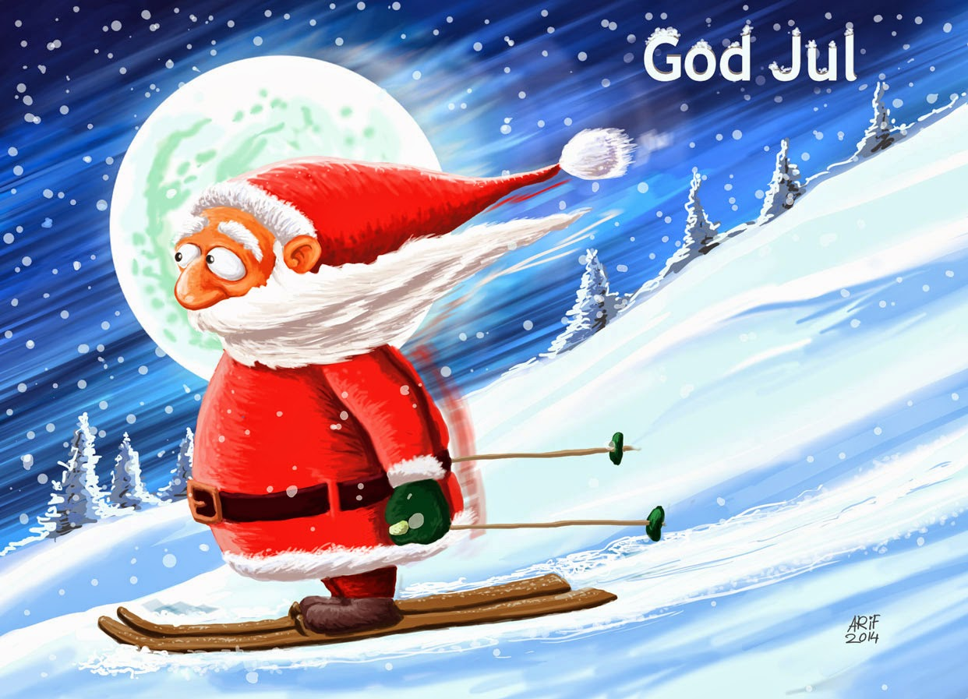
8
1
22
4
16
9
7
2
11
24
13
23
19
6
15
10
20
17
21
3
18
12
14
5

Slide 2
1. december
https://www.youtube.com/watch?v=3iA6HI1Fl1s
Retur

Slide 3
2. december
https://www.youtube.com/watch?v=ei_ur-Jk9UY
Retur

Slide 4
3. december
https://www.youtube.com/watch?v=dT2owtxkU8k
Retur

Slide 5
4. december
https://www.youtube.com/watch?v=La4Dcd1aUcE&list=PLv86K2UUaHEC3YE_ngtWCNVYqUVjgSUQ-&index=10
Retur

Slide 6
5. december
https://www.youtube.com/watch?v=AWYyl--d_fQ
Retur

Slide 7
6. december
https://www.youtube.com/watch?v=zLy4_aXsPZY
Retur

Slide 8
7. december
https://www.youtube.com/watch?v=w-i2_3CAgw4
Retur

Slide 9
8. december
https://www.youtube.com/watch?v=pH1Zaef7XXA
Retur

Slide 10
9. december
https://www.youtube.com/watch?v=u5SmyYVlBCk
Retur

Slide 11
10. december
Retur
https://www.youtube.com/watch?v=sx9zPVpyv0Y

Slide 12
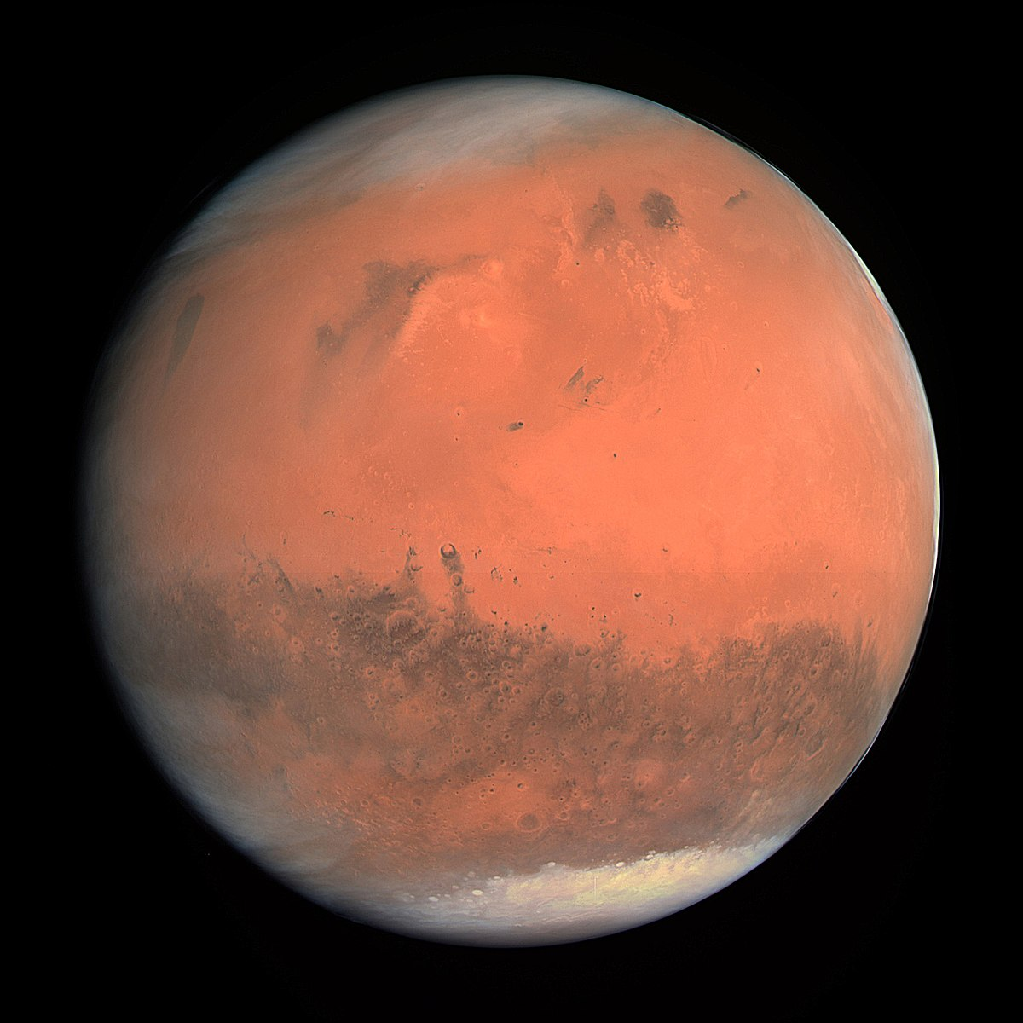
11. december
Retur
https://www.youtube.com/watch?v=LjhCEhWiKXk

Slide 13
12. december
https://www.youtube.com/watch?v=PvZA8NKgrBI
Retur

Slide 14
13. december
https://www.youtube.com/watch?v=_CrFhD9Hw4I&list=PL2F9B7BA01E95D982&index=3
Retur

Slide 15
14. december
https://www.youtube.com/watch?v=94XZHBidkxc
Retur

Slide 16
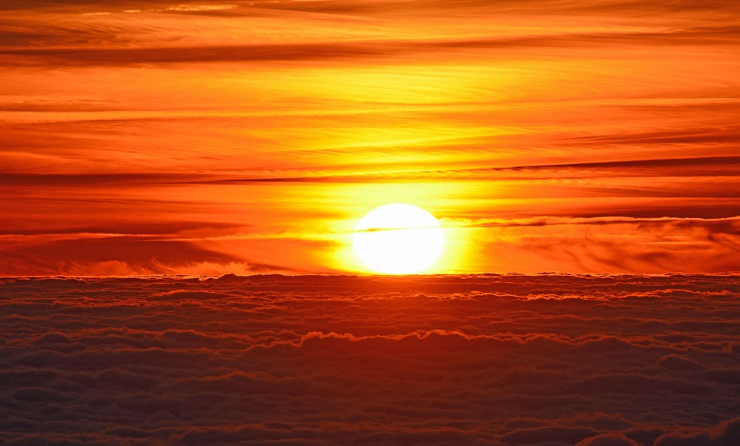
15. december
https://www.youtube.com/watch?v=kXk8LGZENMw
Retur

Slide 17
16. december
Retur
https://www.youtube.com/watch?v=3t6bThwWX70

Slide 18
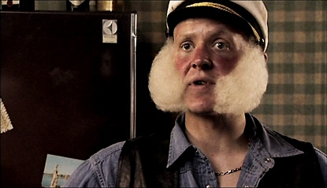
17. december
Retur
https://www.youtube.com/watch?v=-OOsz3sCs9A

Slide 19
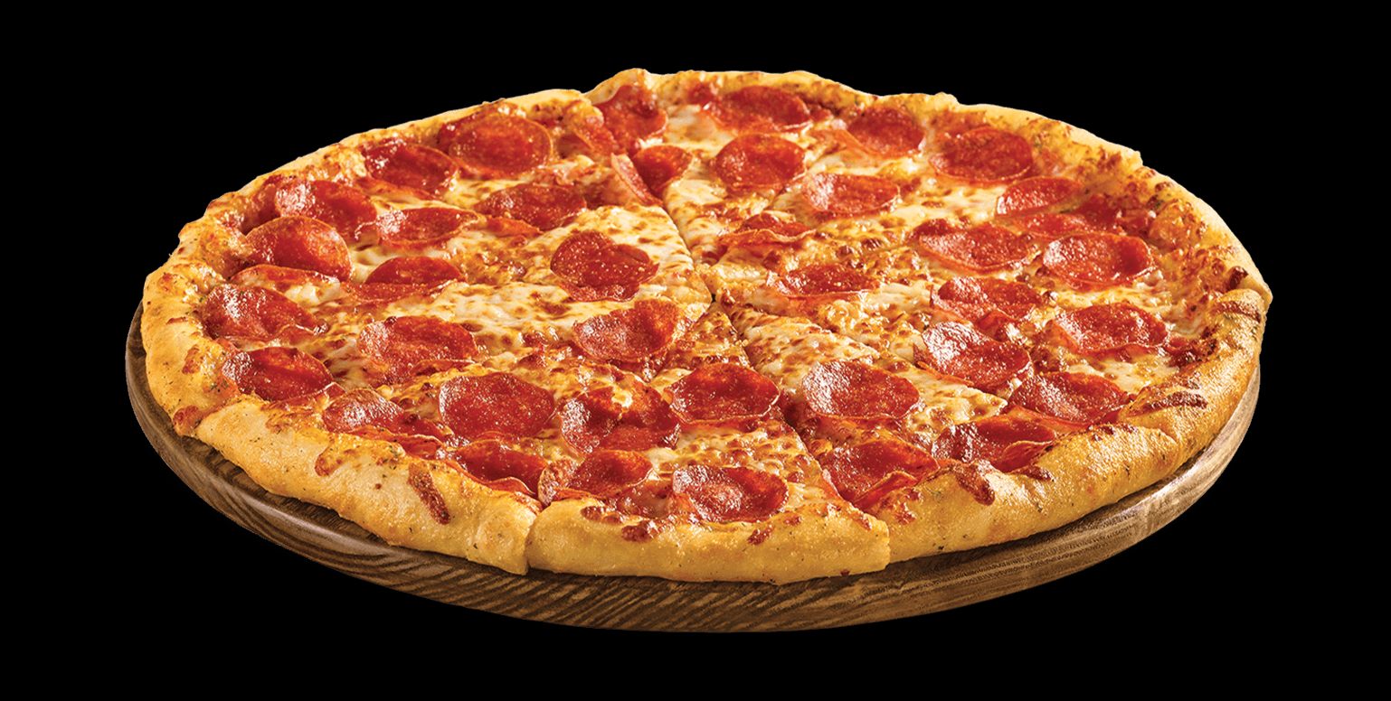
18. december
Retur
https://www.youtube.com/watch?v=cemgBNqGpi0

Slide 20
19. december
https://www.youtube.com/watch?v=y7KOPoOPNyc
Retur

Slide 21
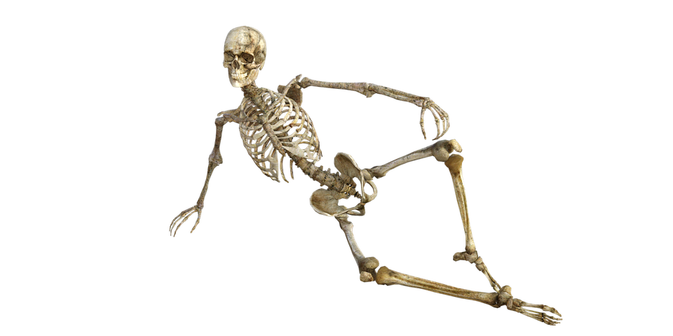
20. december
Retur
https://www.youtube.com/watch?v=2aTx-7bFRN8

Slide 22
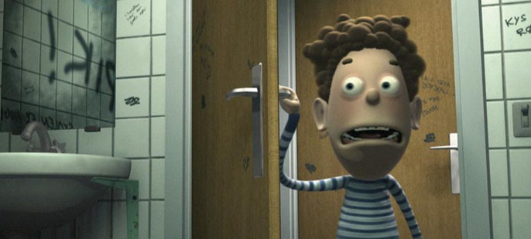
21. december
https://www.youtube.com/watch?v=C1BpcJLsLzM
Retur

Slide 23
22. december
https://www.youtube.com/watch?v=MBw2k4paYug
Retur

Slide 24
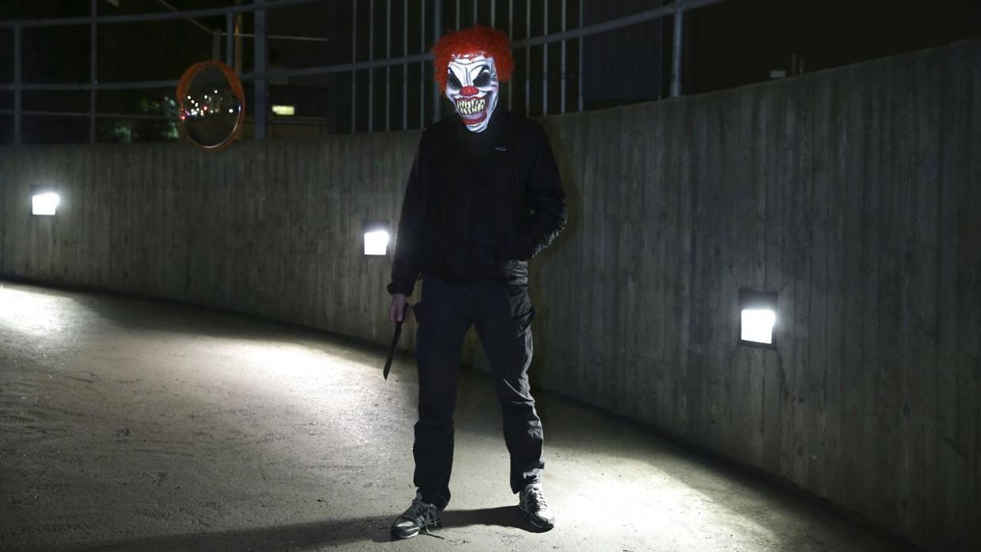
23. december
https://www.youtube.com/watch?v=d8OCnTNX9Bs
Retur

Slide 25
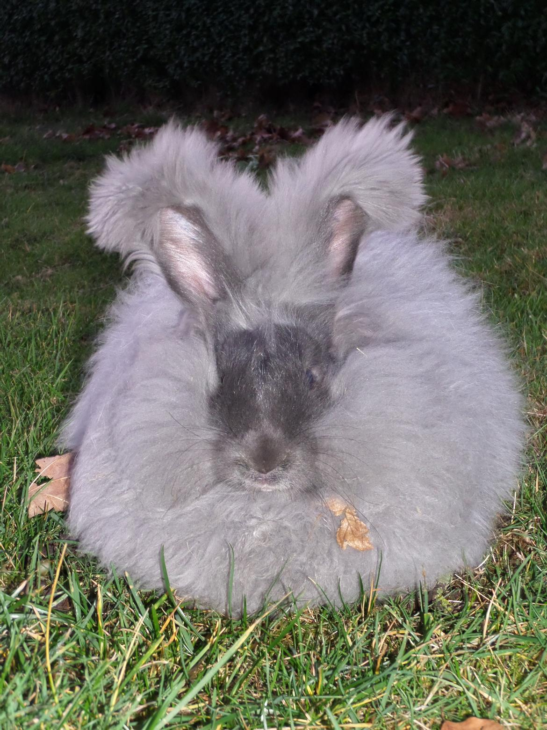
24.december
https://www.youtube.com/watch?v=SFpiOoWFNNg
Retur

