Slide 1
22
6
20
9
1
11
19
15
5
2
17
12
10
13
21
23
8
3
7
16
4
14
18
24

Slide 2
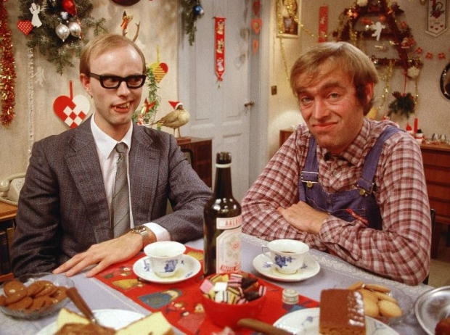
1 december
https://www.youtube.com/watch?v=6c0r8wnZBys
Retur

Slide 3
2. december
https://www.youtube.com/watch?v=ZNfGVE-_rms
Retur

Slide 4
3. december
https://www.youtube.com/watch?v=n9GN2_83sCs
Retur

Slide 5
4. december
https://www.dr.dk/bonanza/serie/356/boern-klip/53948/julekalender-jul-i-gammelby
Retur

Slide 6
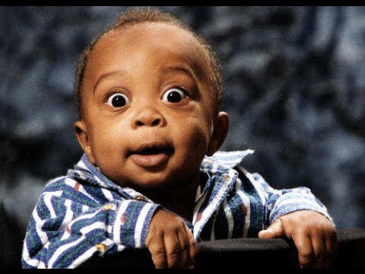
5. december
Retur
https://www.youtube.com/watch?v=DODLEX4zzLQ

Slide 7
6. december
https://www.youtube.com/watch?v=bOjf8zjh42Q
Retur

Slide 8
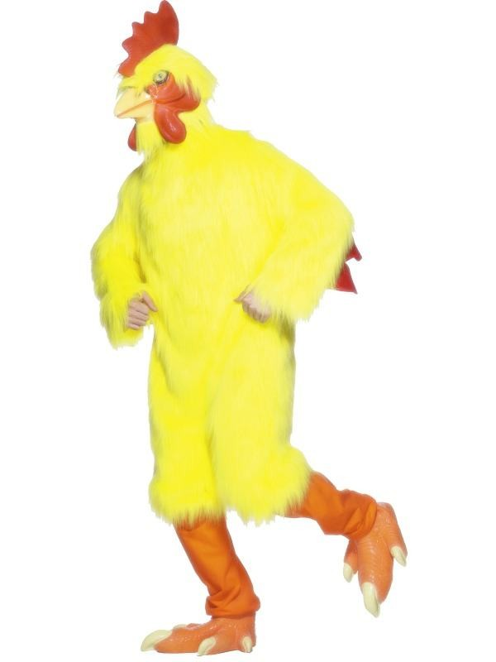
7. december
https://www.youtube.com/watch?v=l5sIspLfmXM
Retur

Slide 9
8. december
Retur
https://www.youtube.com/watch?v=Y0Q5PmbtqIM

Slide 10
9. december
https://www.youtube.com/watch?v=IaGiVLOrR6o
Retur

Slide 11
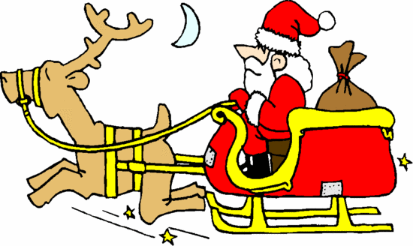
10. december
https://www.youtube.com/watch?v=h_vSSYo3fY8
Retur

Slide 12
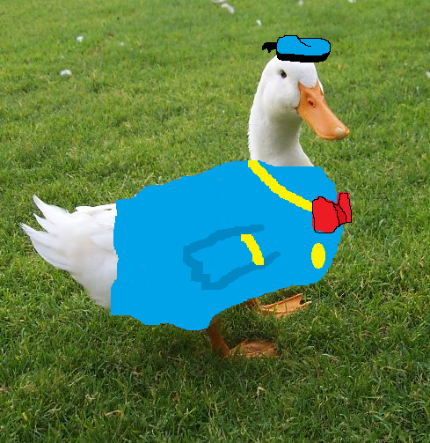
11. december
https://www.youtube.com/watch?v=61WFR1_-YBY
Retur

Slide 13
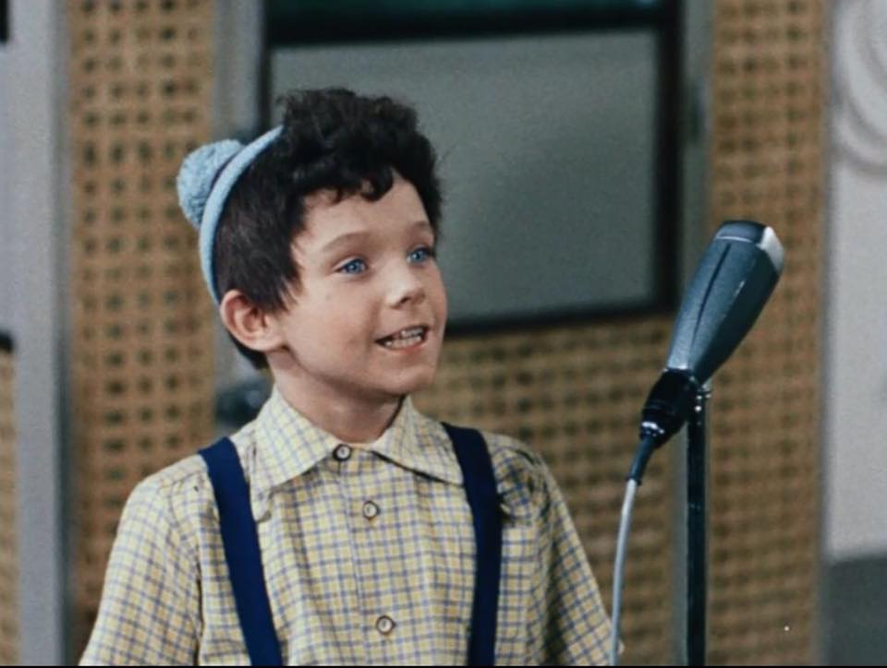
12. december
https://www.youtube.com/watch?v=Nr9VCdp4Dbg
Retur

Slide 14
13. december
https://www.youtube.com/watch?v=GDGsNcD6zsQ
Retur

Slide 15
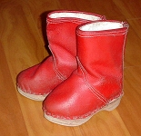
14. december
https://www.youtube.com/watch?v=6QJH3iPqLkw
Retur

Slide 16
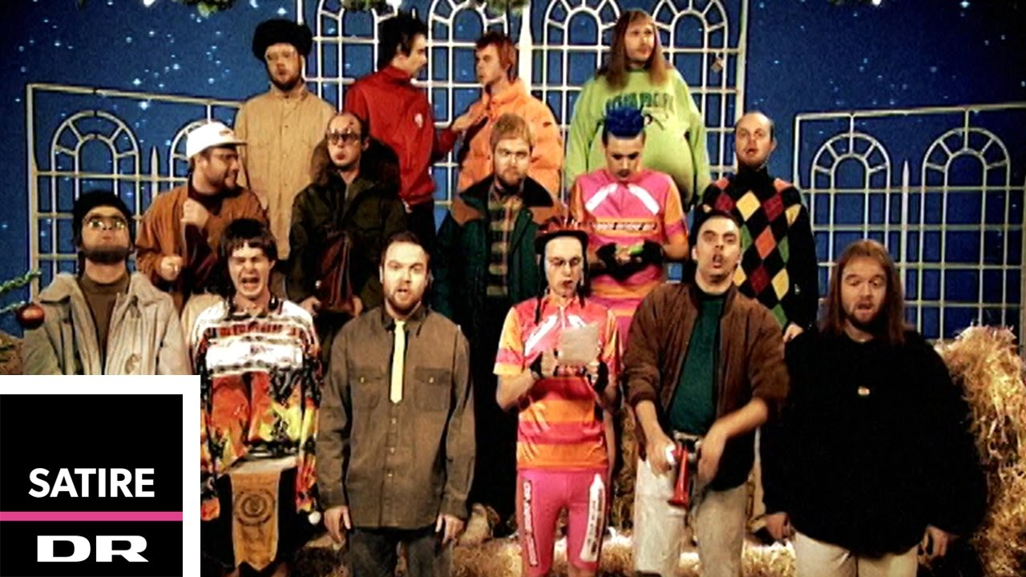
15. december
https://www.youtube.com/watch?v=SFpiOoWFNNg
Retur

Slide 17
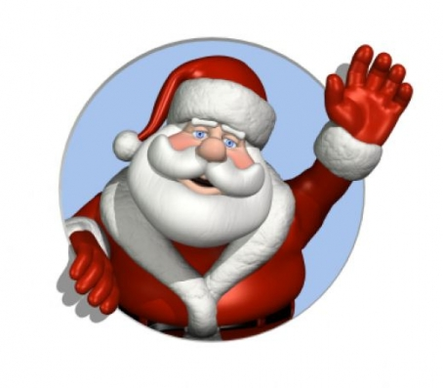
16. december
https://www.youtube.com/watch?v=YYjDtFMCRl4
Retur

Slide 18
17.december
Retur
https://www.youtube.com/watch?v=8CCuF4AuqK4

Slide 19
18. december
Retur
https://www.youtube.com/watch?v=hasJBmVzt-U

Slide 20
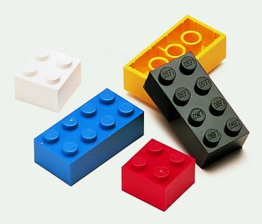
19. december
https://www.youtube.com/watch?v=-8B5pg9mrmI
Retur

Slide 21
20. december
https://www.youtube.com/watch?v=9dco8ND0chc
Retur

Slide 22
21. december
https://www.youtube.com/watch?v=f4KNeYz0OvU
Retur

Slide 23
22. december
https://www.youtube.com/watch?v=O2SRLHvZFQI
Retur

Slide 24
23. december
Retur
https://www.youtube.com/watch?v=GZ5bFUfwW80

Slide 25
24. december
https://www.youtube.com/watch?v=L2UCRNldC3s
Retur

